Slide 1

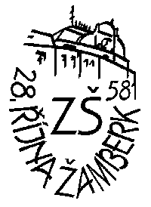
Tomorrow Is on Our Hands Plants in our park By Matouš and Dorotka from Žamberk Czech Republic

Slide 2

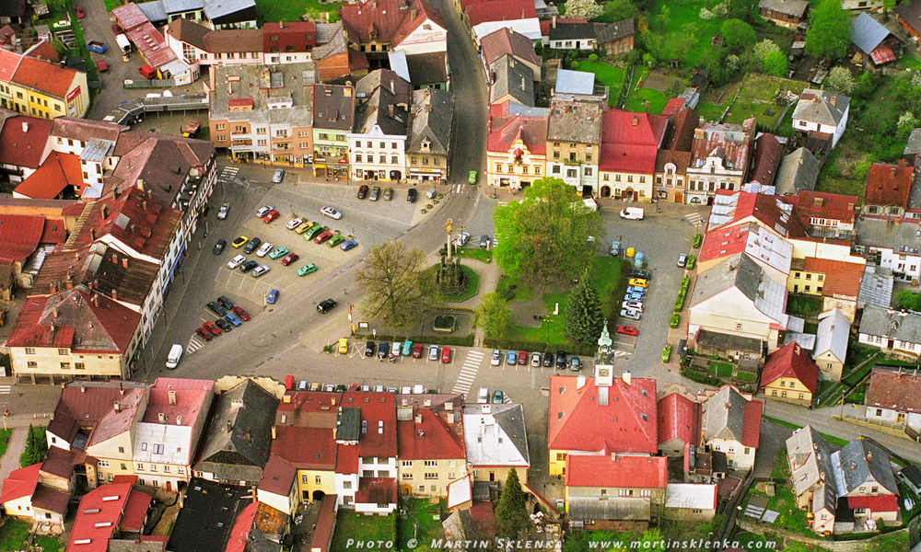
zamberk Czech Republic

Slide 3
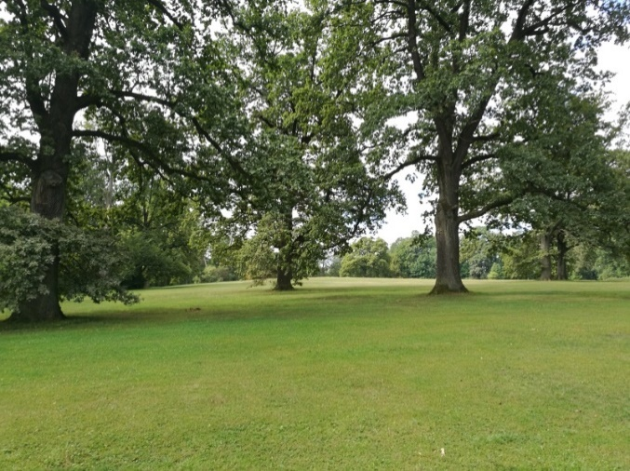
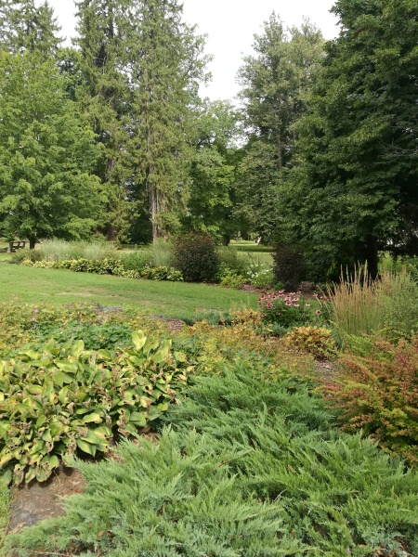
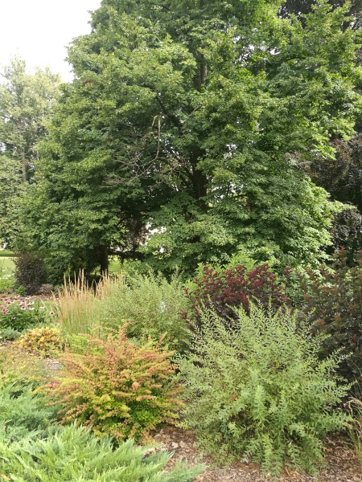
Typical Plants in Our Park
Typical trees are:
Dub / oaks (euks)
Borovice / pines (pajns)
Jasan / ash-trees (eš tryz)
Topol / poplars (poplaz)
Tis / yew-trees (ju tryz)
Javor / maples (mejplz)

Slide 4
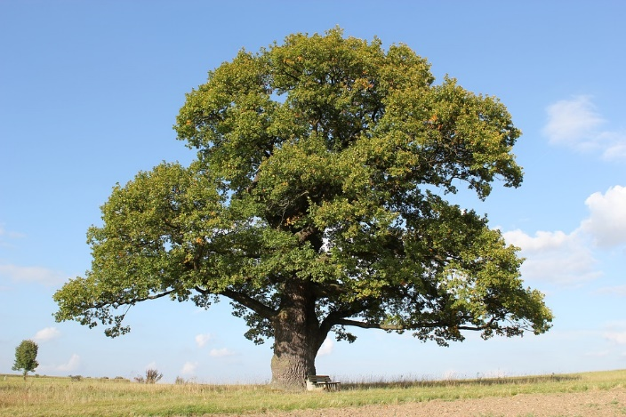
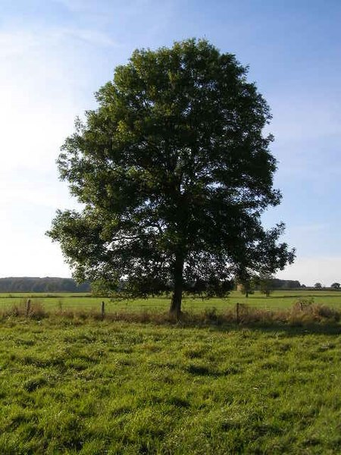
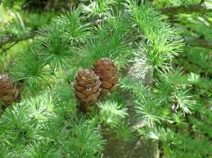
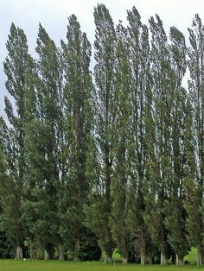
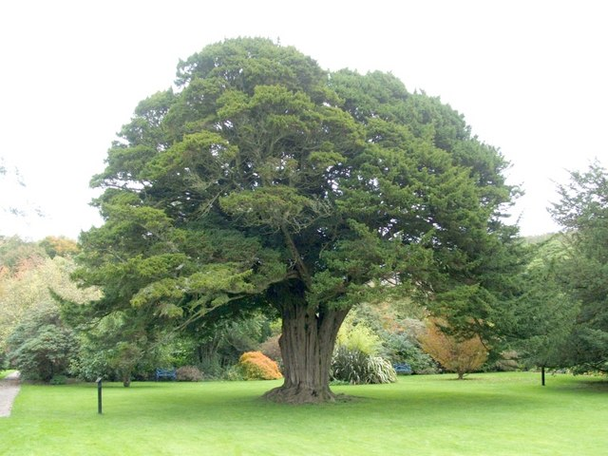
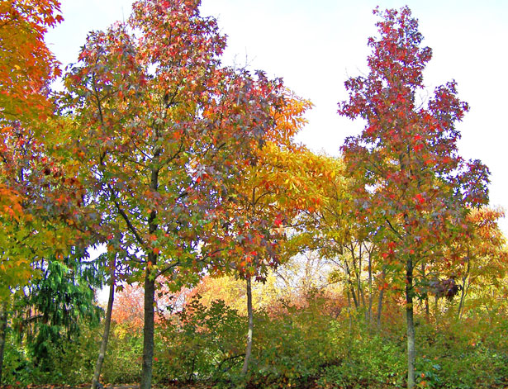
Dub / an oak (en euk)
Borovice / a pine (e pajn)
Jasan / an ash-tree (en eš try)
Topol / a poplar (e popla)
Tis / a yew-tree (e ju try)
Javor / a maple (e mejpl)

Slide 5


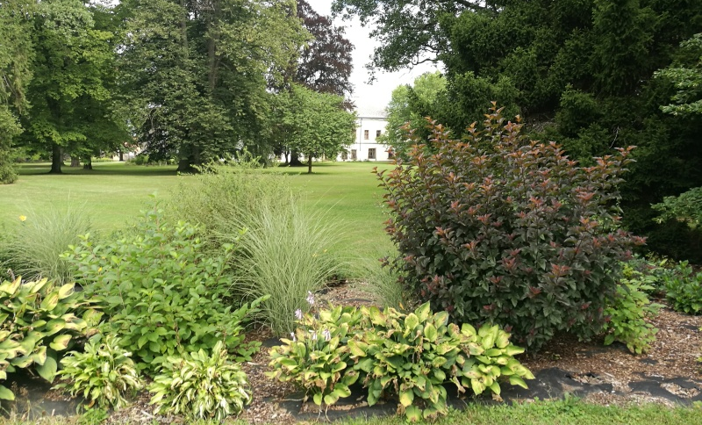
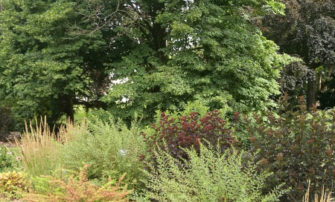
Typical Plants in Our Park

Slide 6
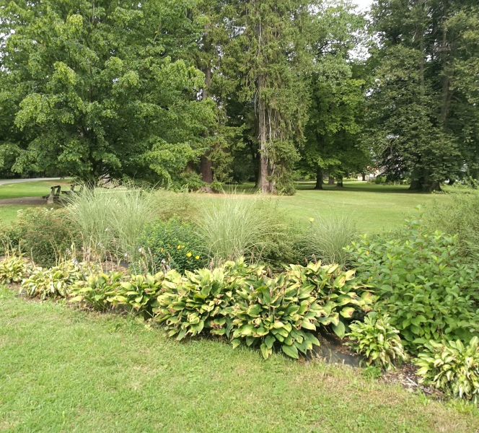
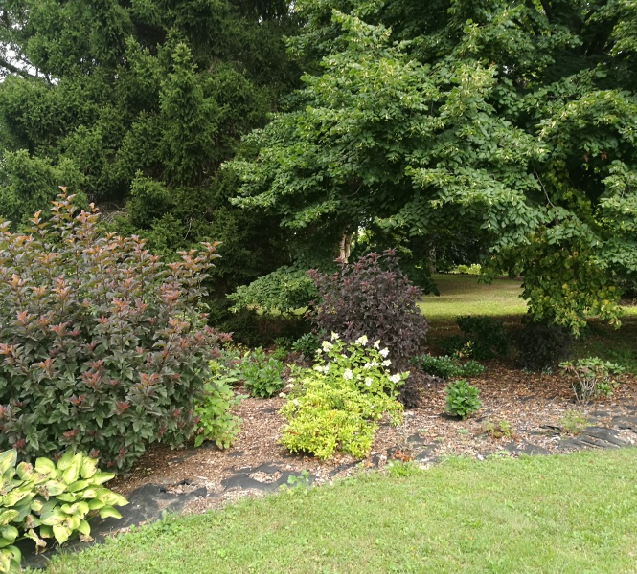
Typical Plants in Our Park

Slide 7
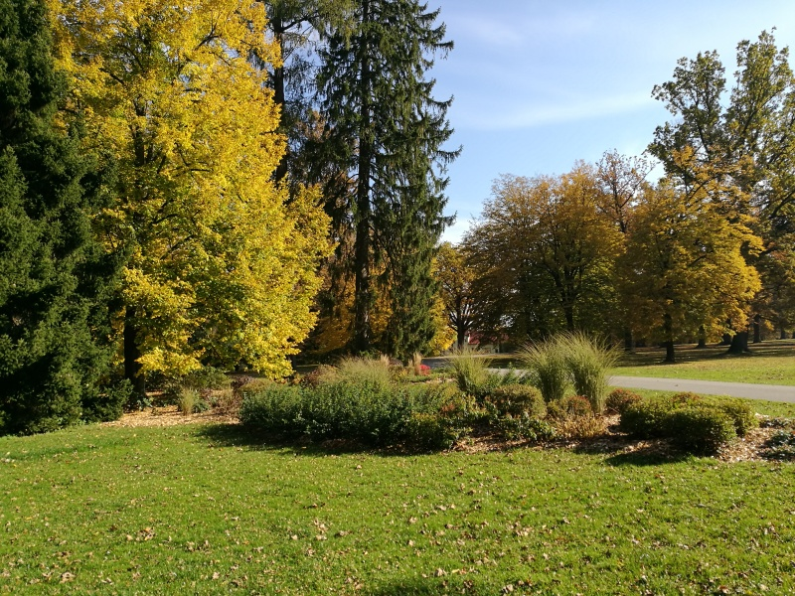
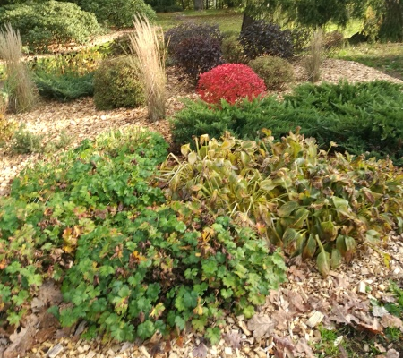
Typical Plants in Our Park

Slide 8
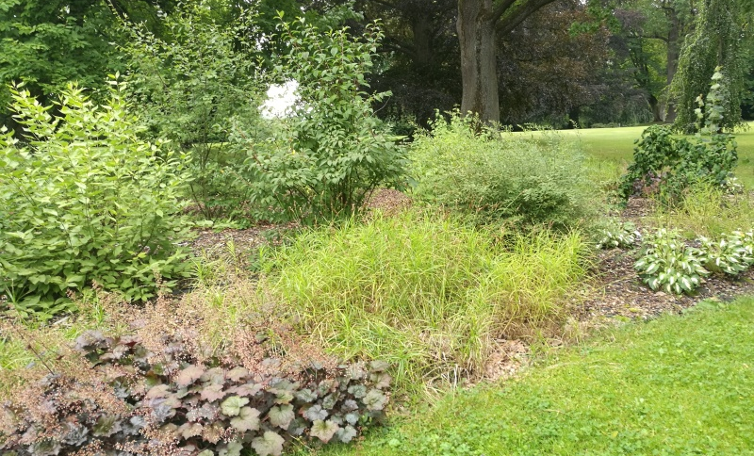
Typical Plants in Our Park

Slide 9
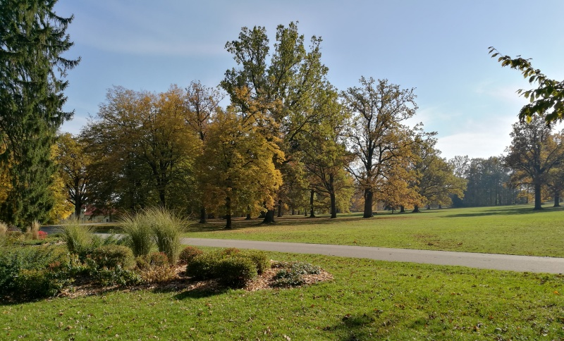
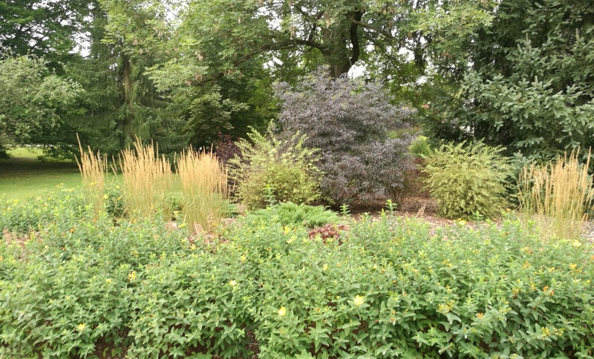
Typical Plants in Our Park

