Slide 1


Tomorrow Is on Our Hands Plants in My Garden By Lucie from Zamberk Czech Republic

Slide 2



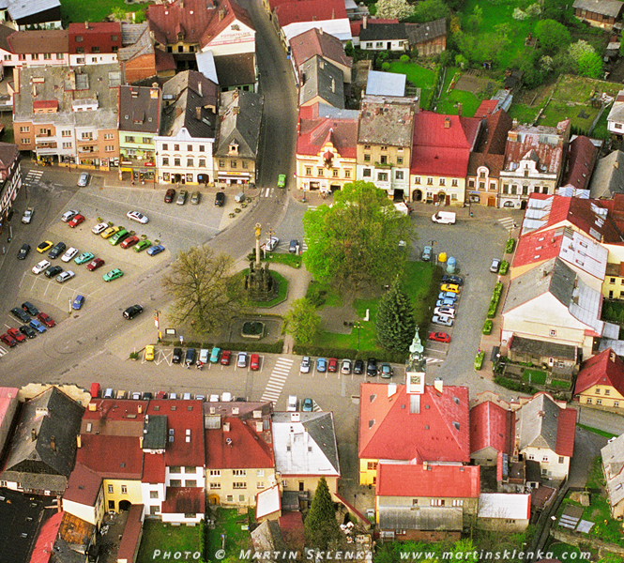
zamberk Czech Republic

Slide 3
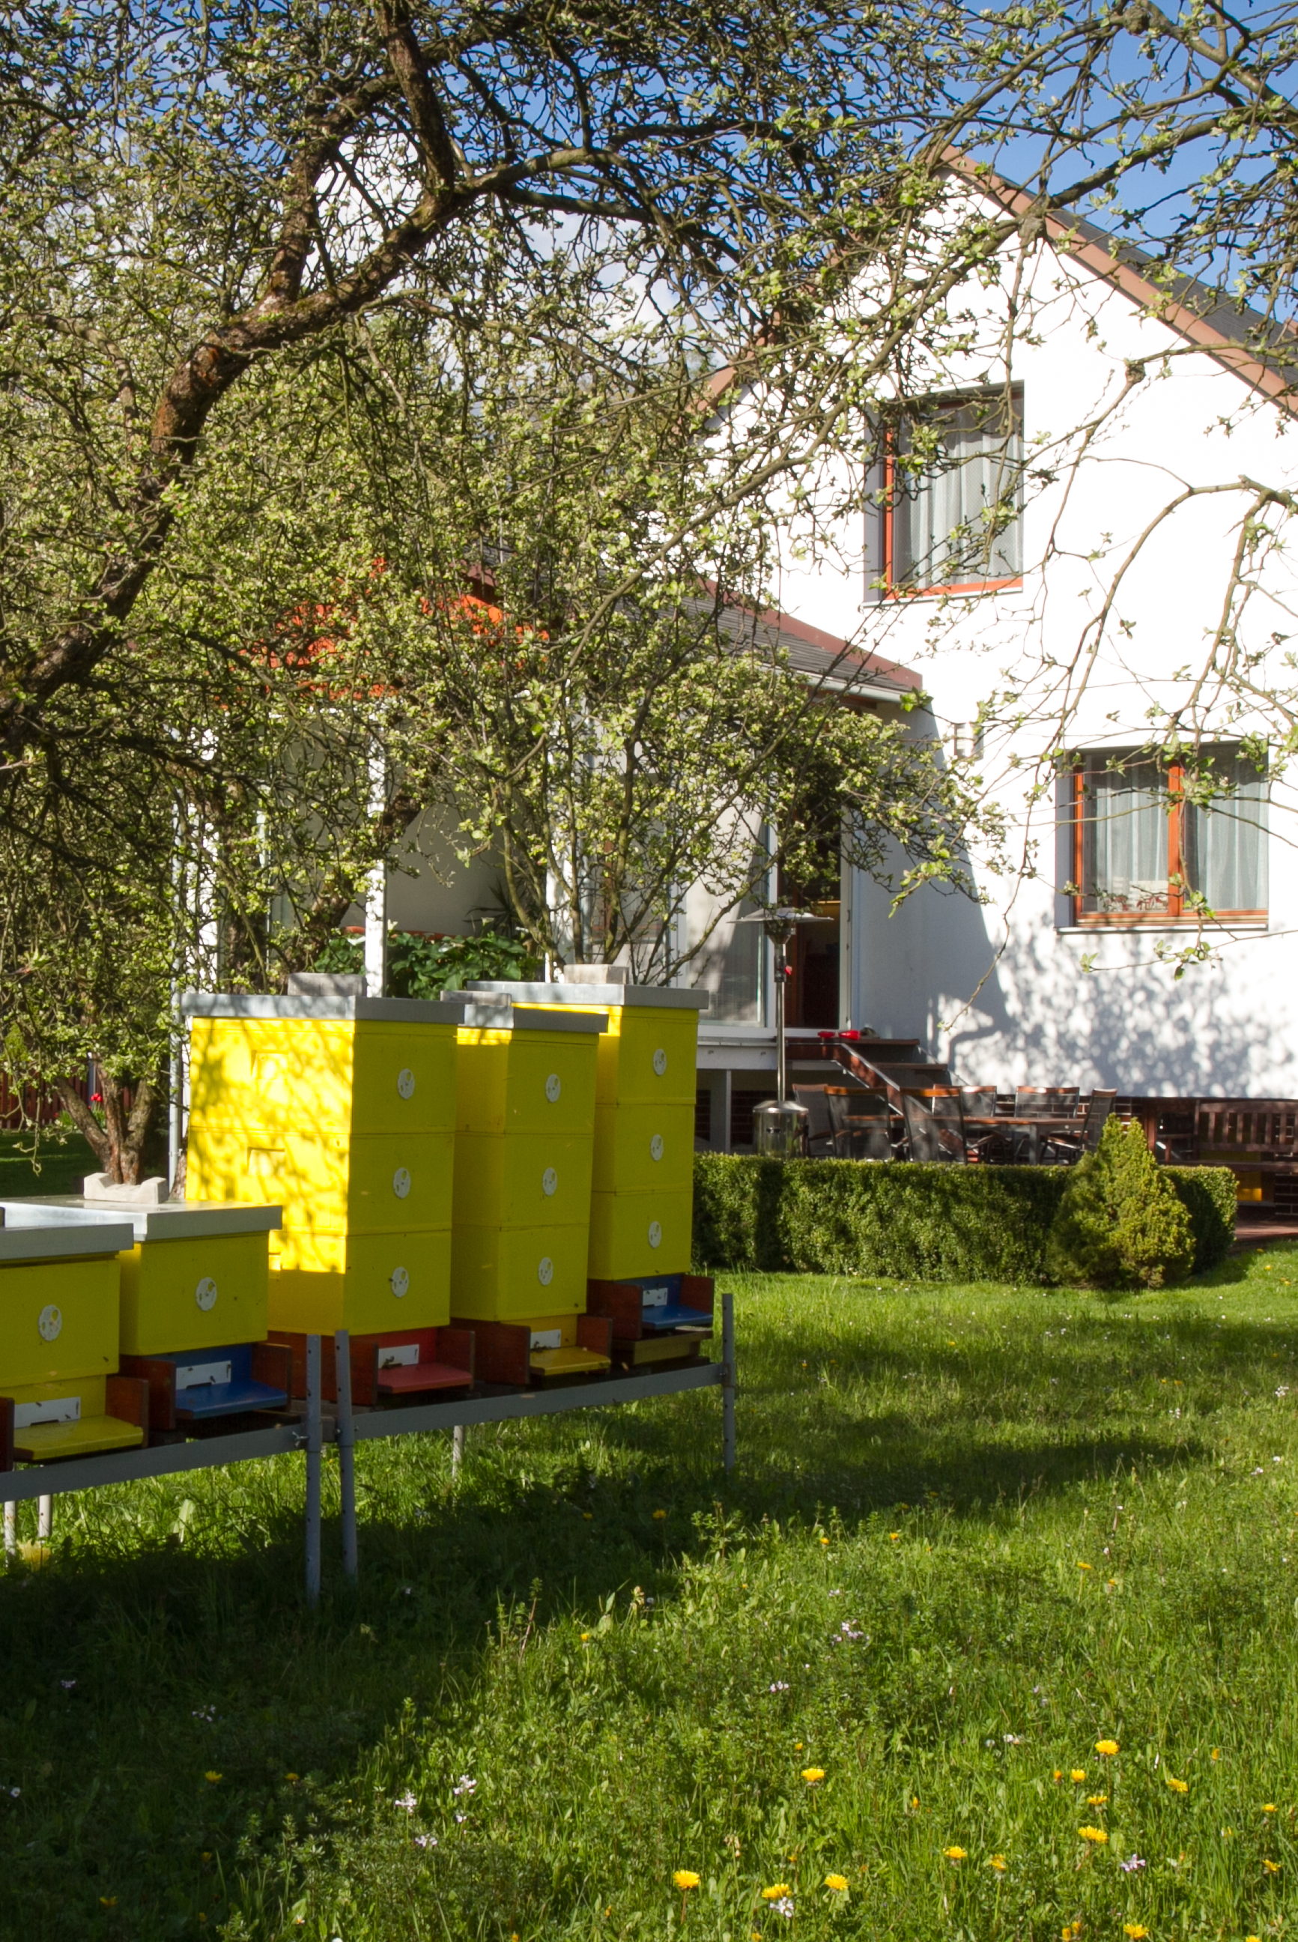
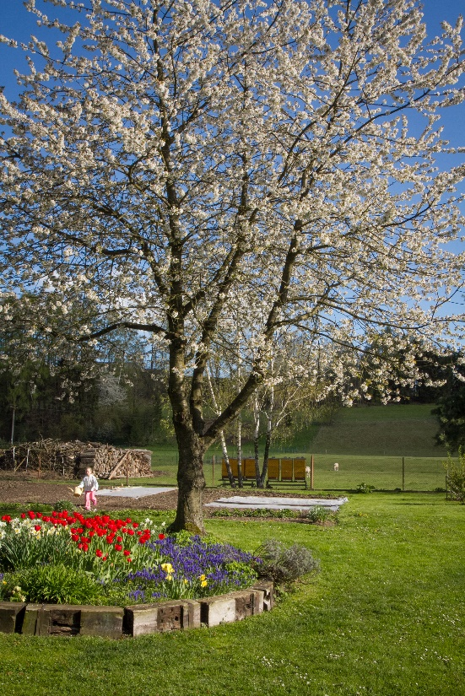
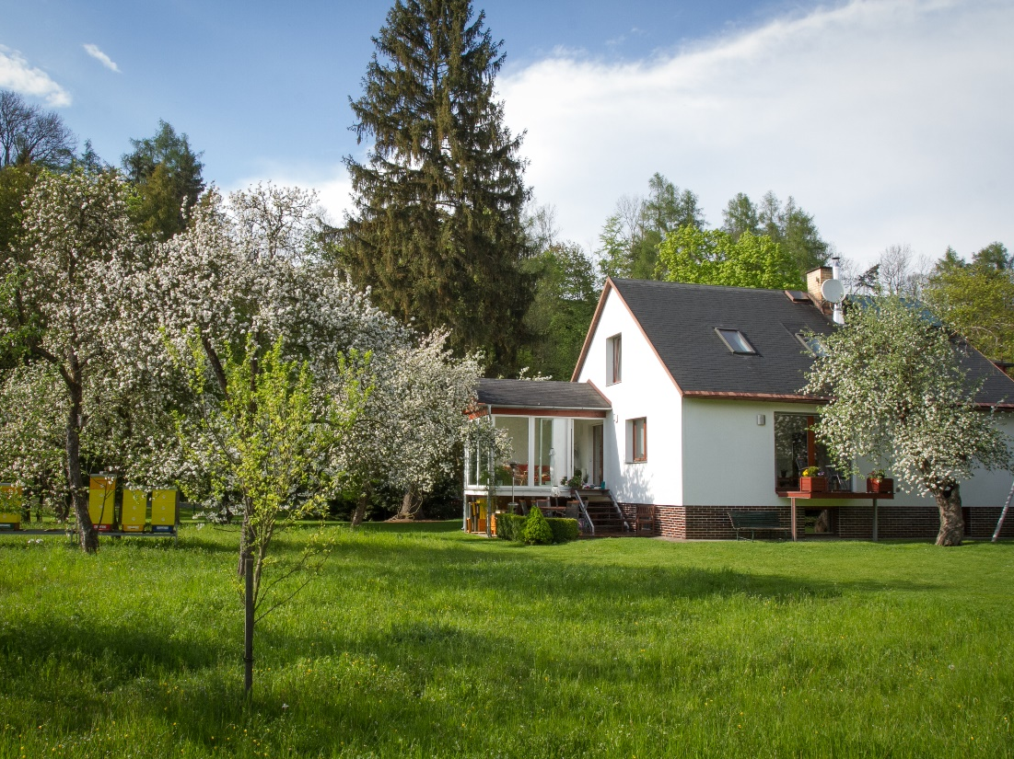
Our Garden
in Spring

Slide 4
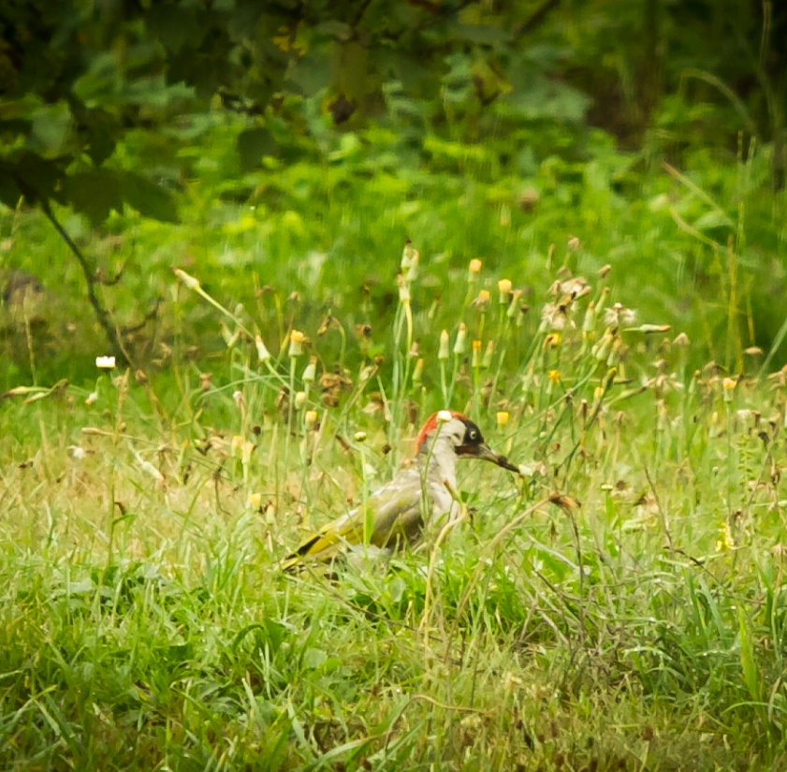
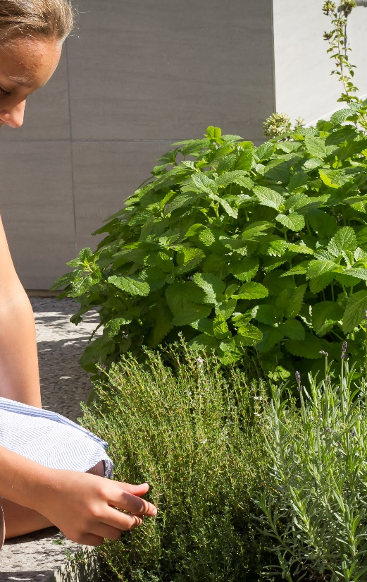
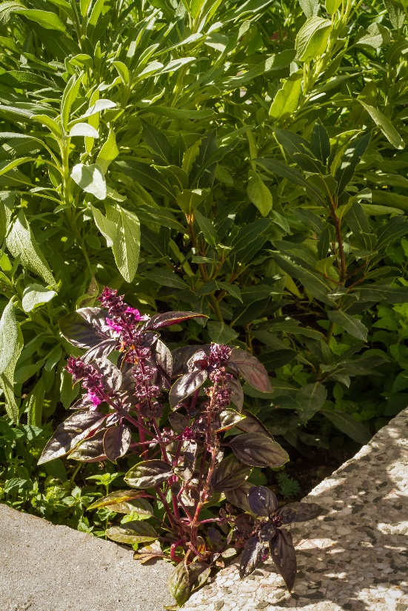
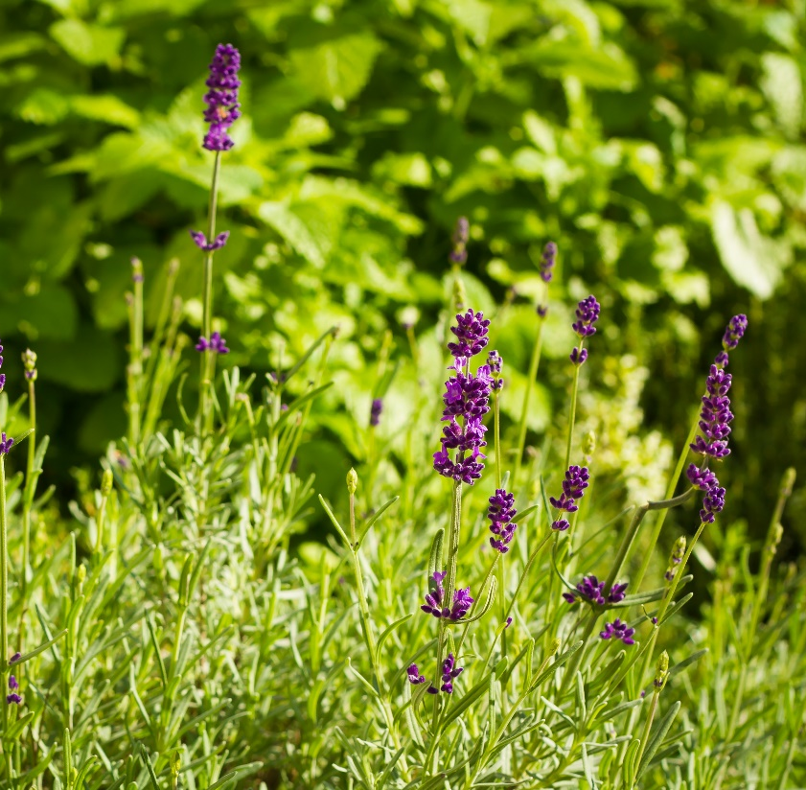
There are a lot of plants in my garden

Slide 5
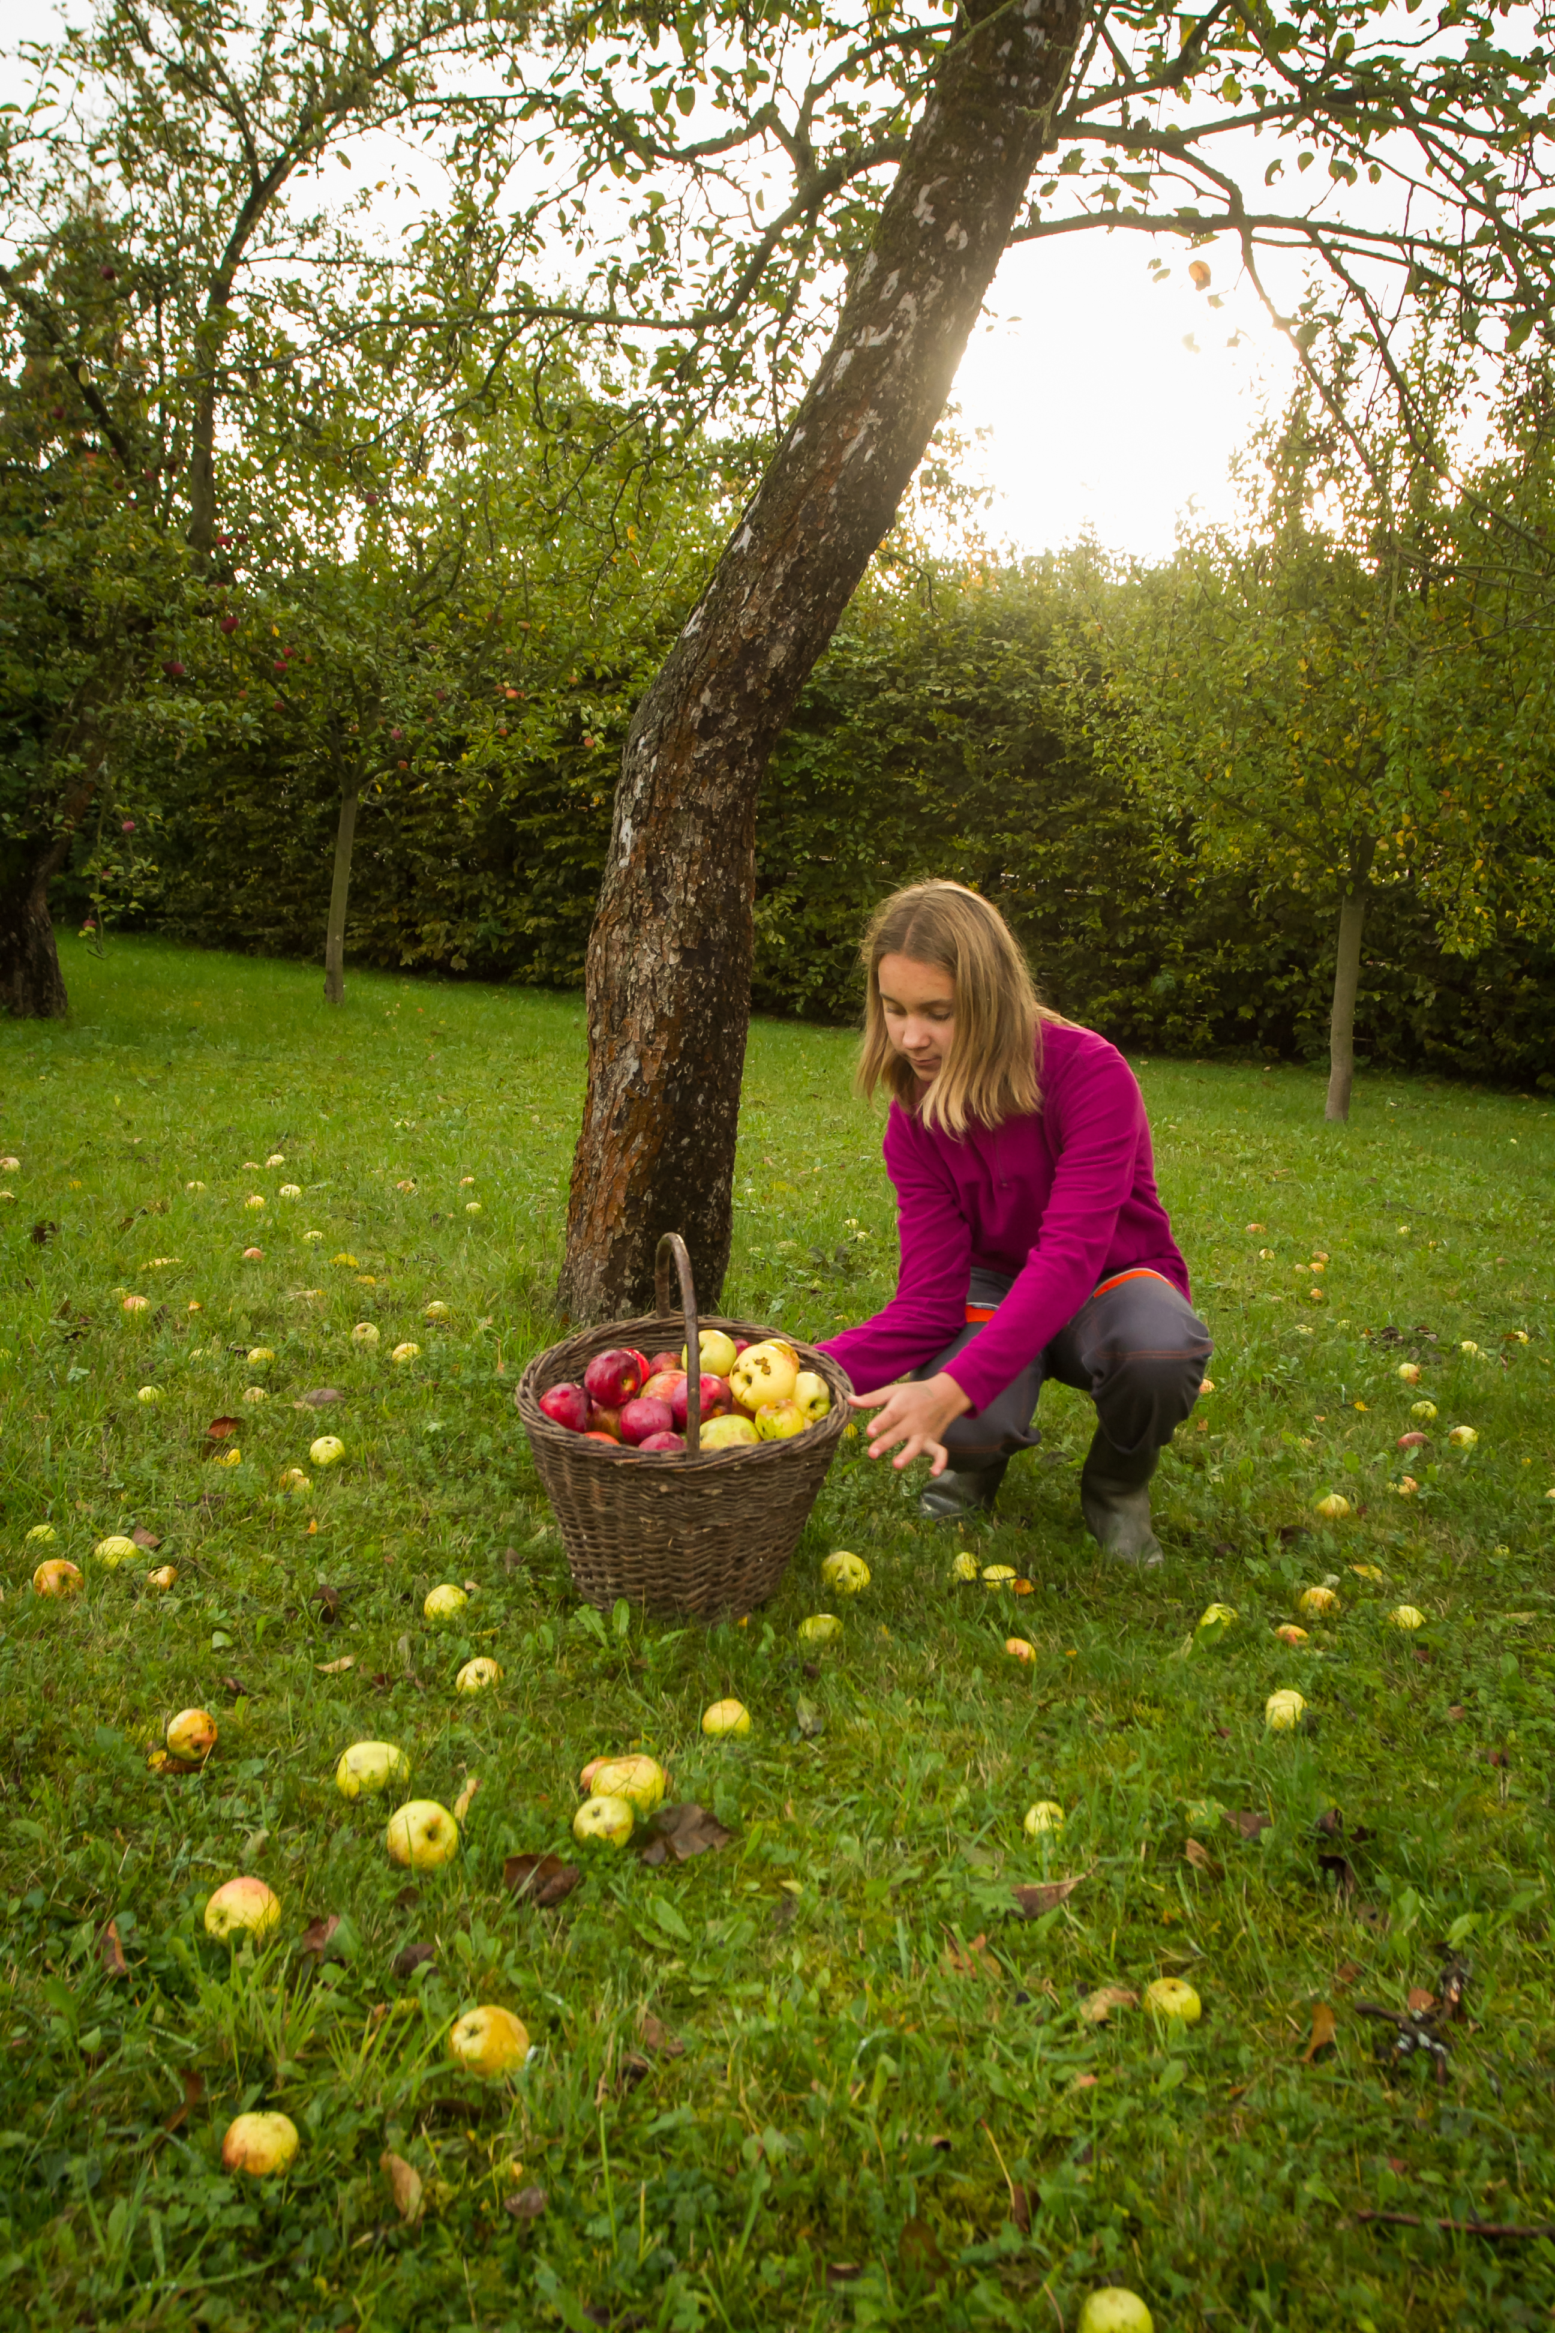
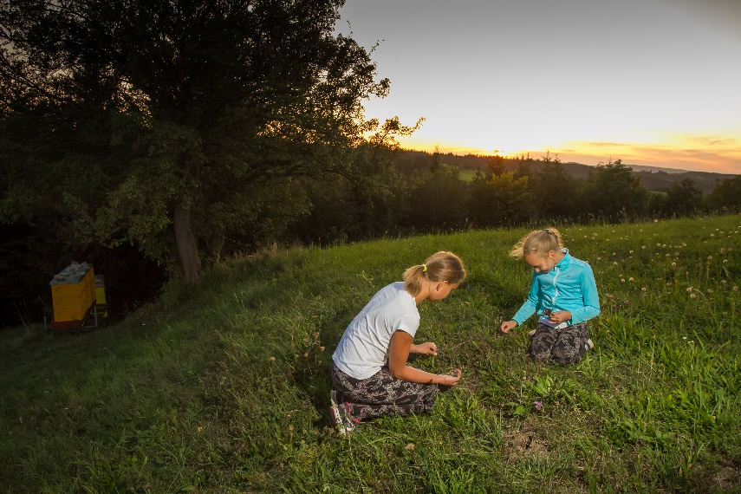
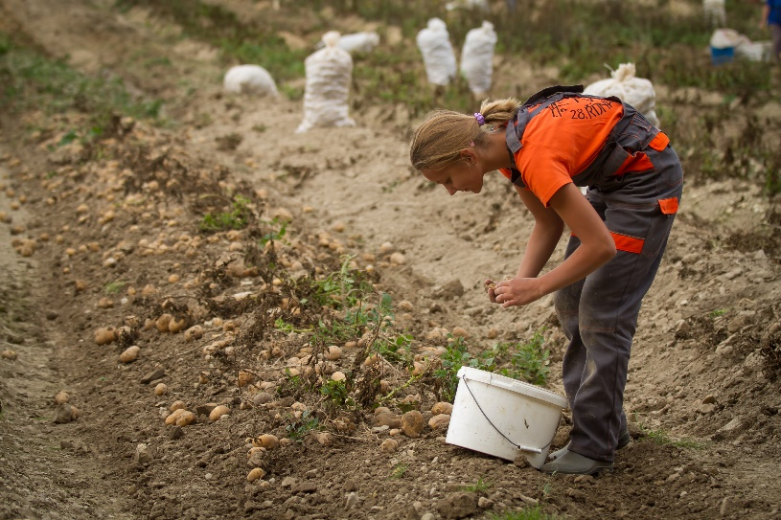
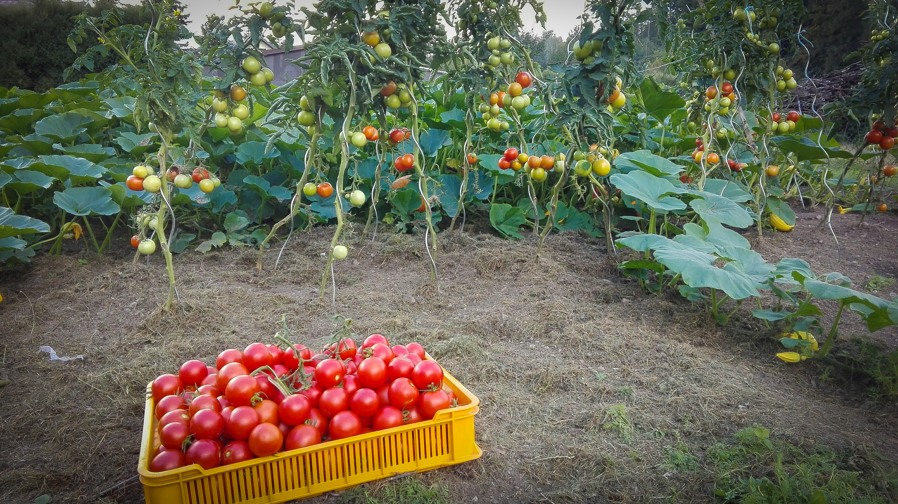
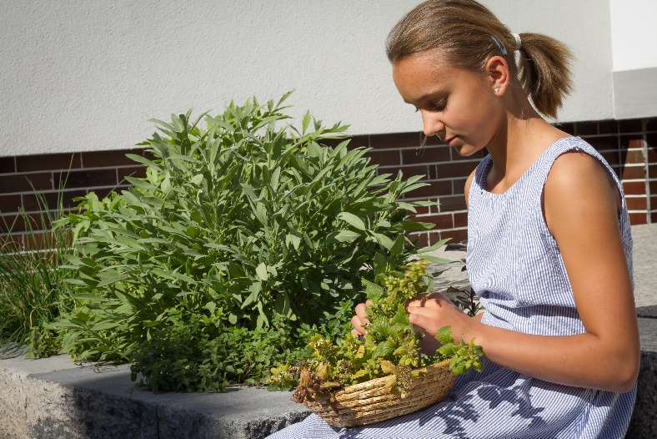
I have to do a lot of things in our garden

Slide 6
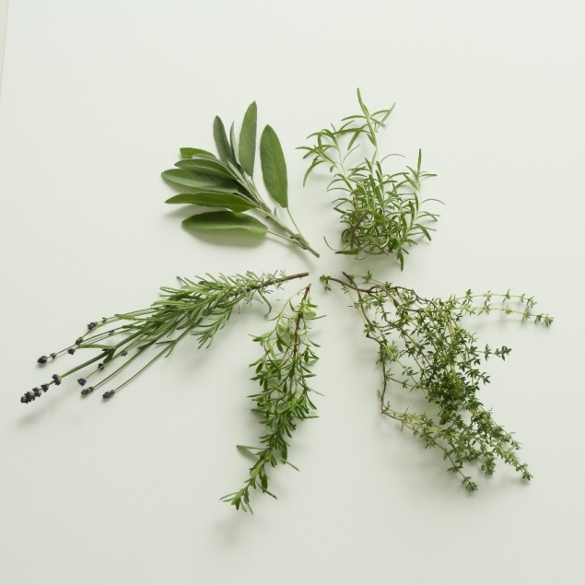
Herbs from my garden
1.Šalvěj / sage (sejdž)
2. Rozmarýn / rosemary (reuzmery)
3. Tymjan / thyme (tajm)
4. Saturejka / savory (sejvery)
5. Levandule / lavender (levenda)

Slide 7
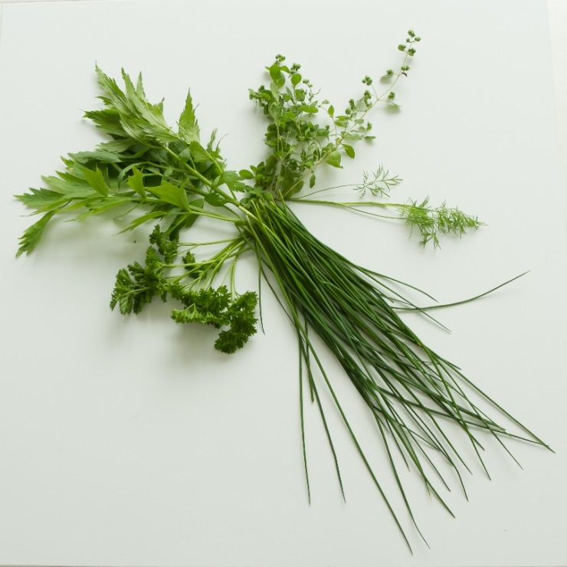
Herbs from my garden
Libeček / lovage (lavydž)
majoranka / marjoram (madžerem)
Kopr / dill (dyl)
Pažitka / chives (čajvz)
Petrželka / parsley (pasly)

Slide 8
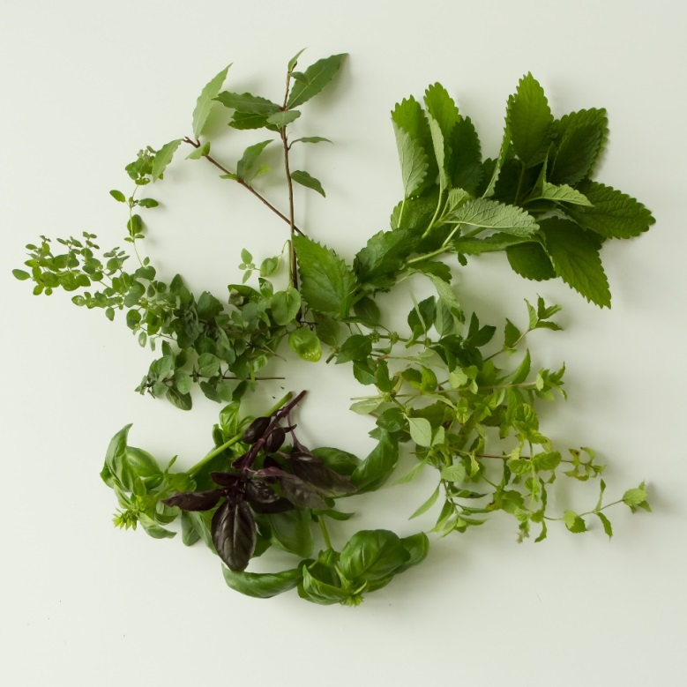
Herbs from my garden
Bobkový list / bay leaf (bej lyf)
Meduňka / balm (bam)
Máta / mint (mynt)
Bazalka / basil (bezel)
Oregano / oregano (origaneu)

Slide 9
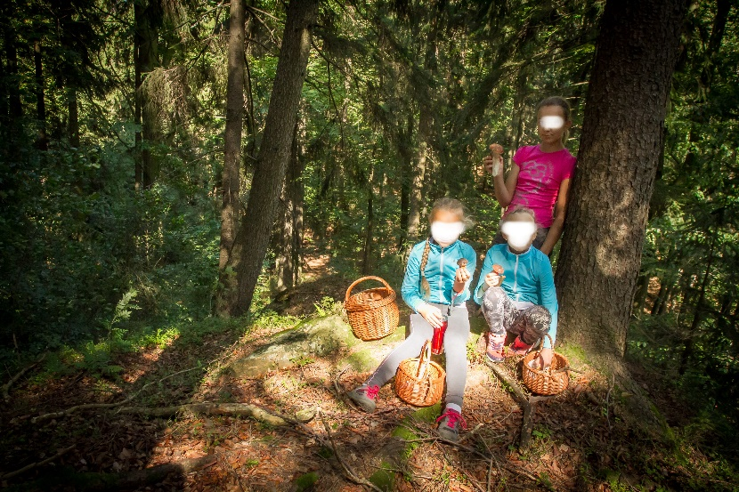
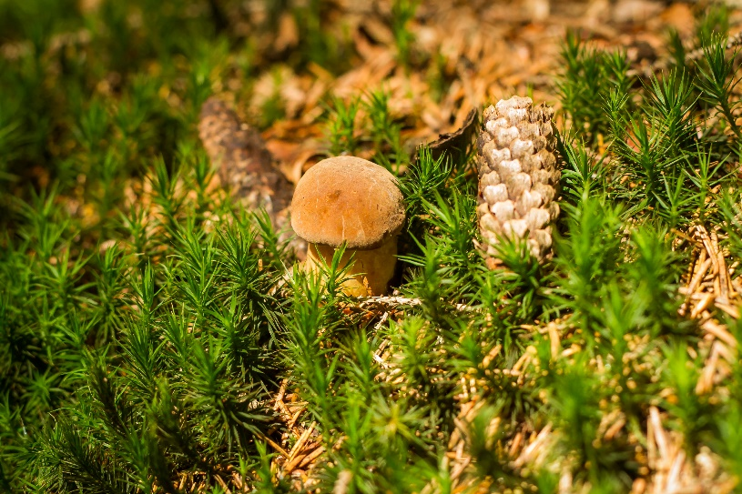
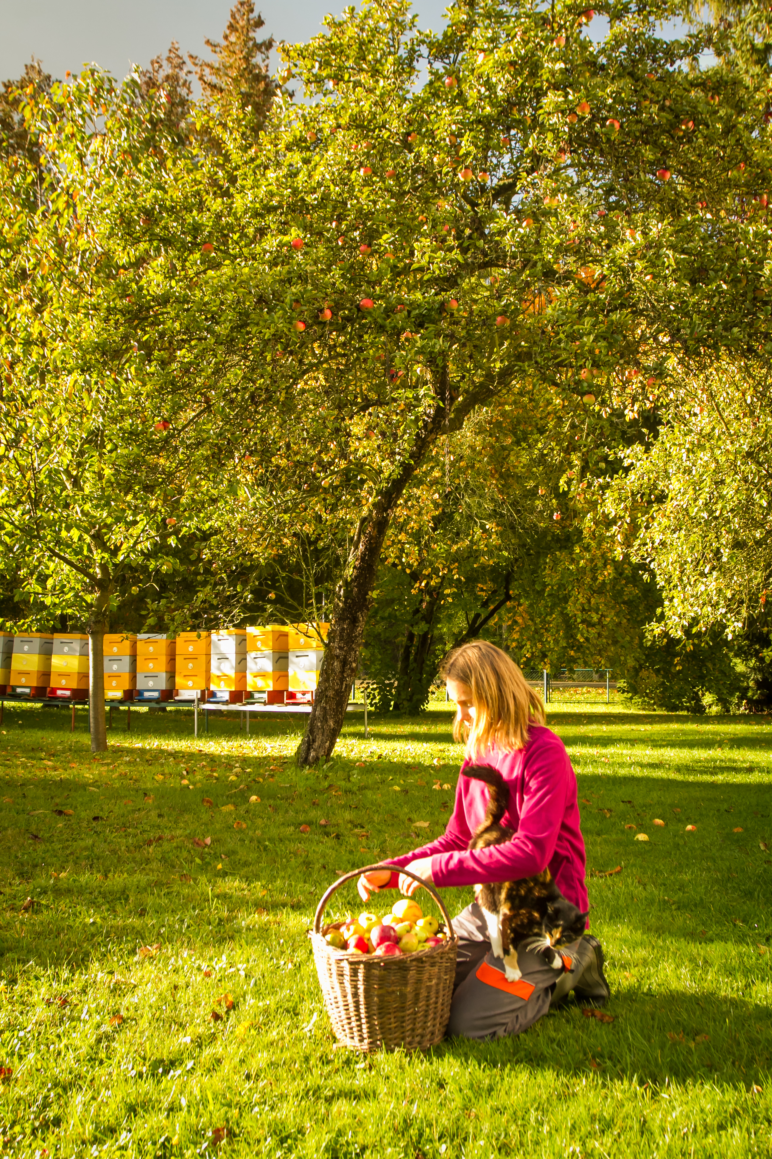
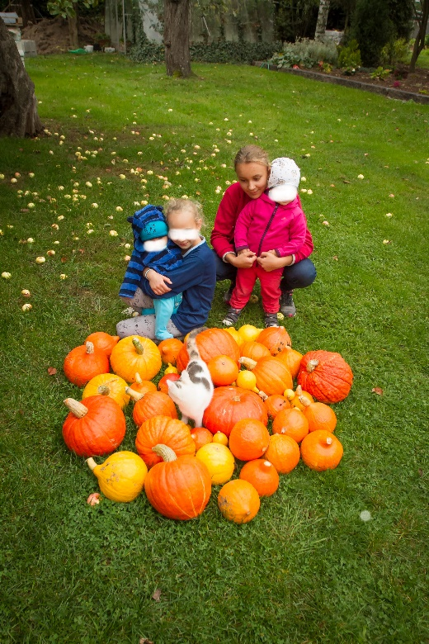
Autumn in the garden

